Slide 1
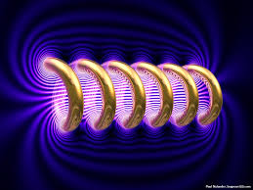


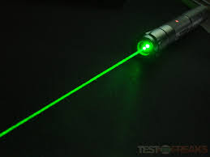
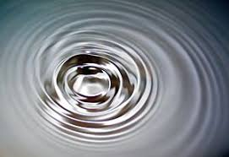

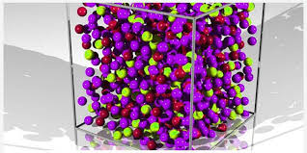
Engineering Physics
PHY-109
Waves-2
ELECTROMAGNETIC THEORY
QUANTUM MECHANICS
LASER
WAVES
Dr. Jeeban Pd Gewali
Department of Physics
Lovely Professional University
Phagwara, Punjab-144411
SOLID STATE PHYSICS
FIBER OPTICS

Slide 2
Syllabus
Interference phenomenon and Concept of resonance
Audible, ultrasonic and infrasonic waves. Production of ultrasonic waves by magnetostriction method, Production of ultrasonic waves by piezoelectric method.
Ultrasonic transducers and their uses, applications of ultrasonic waves, detection of ultrasonic waves (Kundt's tube method, sensitive flame method and piezoelectric detectors),
Absorption and Dispersion of ultrasonic waves.
Superposition of two waves, sound wave and its velocity, standing waves, Formation of beats, Supersonic and shock waves.

Slide 3
Introduction
The word ultrasonic combines the Latin roots ultra, meaning ‘beyond’ and sonic, or sound.
The sound waves having frequencies above the audible range i.e. above 20,000 Hz are called ultrasonic waves.
Generally these waves are called as high frequency waves.
The field of ultrasonics have applications for imaging, detection and navigation.
The broad sectors of society that regularly apply ultrasonic technology are the medical community, industry, the military and private citizens.

Slide 4
Introduction
Sound waves can be generated in all three forms of matter, viz., Solid, Liquid and Gas. On the basis of their frequencies they can be divided into three classes:
Subsonic or Infrasonic waves: Frequency less than the lower limit (20 Hz) of audible range of humans. Produced during Earthquakes.
Sonic or Audible waves: The human ear can perceive the sound waves of frequency ranging from 20 Hz to 20 KHz are known as audible waves. Produced by music instruments such as violin and guitar.
Ultrasonic waves: The sound waves having frequencies greater than the upper limit of the audible range (i.e., above 20 KHz ) are known as supersonic or ultrasonic waves. Some animals such as bats, cats, dogs and rats can produce and hear ultrasonic waves. Used for communication by flying bats and also dolphins.

Slide 5
Properties of Ultrasonic Waves
(1) They have a high energy content.
(2) Just like ordinary sound waves, ultrasonic waves get reflected, refracted and absorbed.
(3) They can be transmitted over large distances with no appreciable loss of energy.
(4) If an arrangement is made to form stationary waves of ultrasonic in a liquid, it serves as a diffraction grating. It is called an acoustic grating.
(5) They produce intense heating effect when passed through a substance.
Application of ultrasound: https://www.youtube.com/watch?v=yZty_W8ySng

Slide 6
Production of Ultrasonic Waves
Ultrasonic waves are produced by the following methods.
(1) Magnetostriction generator or oscillator
(2) Piezoelectric generator or oscillator

Slide 7
Magnetostriction Method

Slide 8
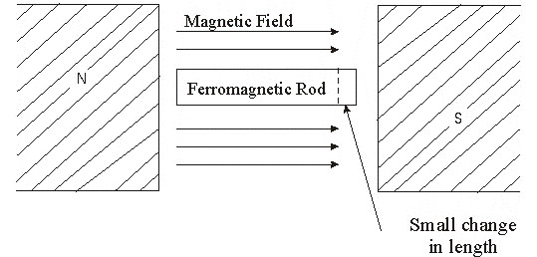
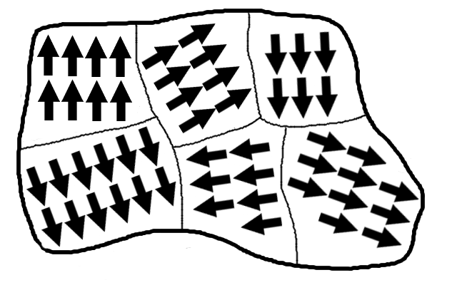
Magnetostriction Method
Magnetostriction effect
When a ferromagnetic rod like iron or nickel is placed in a magnetic field parallel to its length, the rod experiences a small change in its length. This is called magnetostriction effect.
Principle:
The principle is to cause the ferromagnetic materials to vibrate very rapidly. These vibrations cause surrounding air to vibrate with the same frequency, which spread out in the form of ultrasonic waves.
The change in length (increase or decrease) produced in the rod depends upon the strength of the magnetic field, the nature of the materials and is independent of the direction of the magnetic field applied.
The reason for the change is length is that the ferromagnetic materials have a structure that is divided into domains, each of which is a region of uniform magnetic polarization. Under the application of an external magnetic field the boundaries between the domains shift and the domain rotates. These two effect lead to change in the dimension of the material.
Ferromagnetic domain

Slide 9
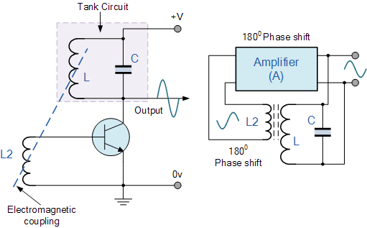
Magnetostriction Method
For the sustained and continuous change in the length of the rod over time, a continuous change in magnetic field is required. This is provided by an LC oscillator. However, the oscillations of the LC is not sustained for long time and rather damps out. Therefore an oscillator circuit is followed by the amplifier circuit.
An Oscillator is a circuit that produces a Periodic Waveform with only DC Power supply. Depending on the type of Oscillator, the Output Waveform can be sinusoidal or non-sinusoidal.
Feedback is a process in which part of the Output Signal is returned to its Input in order to regulate its further Output.
Amplifier
Output of BJT amplifier
Is given to the LC oscillator.
Feedback circuit takes
A part of the output
oscillation of LC and gives
It to the amplifier
Feedback Circuit
LC Oscillator
Electromagnetic Coupling
Between LC and Feedback
circuit
http://www.electronics-tutorials.ws/oscillator/oscillators.html
http://www.learnabout-electronics.org/Oscillators/osc11.php

Slide 10
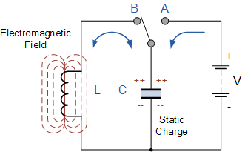
Basics of LC Oscillator Circuit or tank circuit
The circuit consists of an inductive coil, L and a capacitor, C. The capacitor stores energy in the form of an electrostatic field and which produces a potential (static voltage) across its plates, while the inductive coil stores its energy in the form of an electromagnetic field. The capacitor is charged up to the DC supply voltage V, by putting the switch in position A. When the capacitor is fully charged the switch changes to position B.
The charged capacitor is now connected in parallel across the inductive coil so the capacitor begins to discharge itself through the coil. The voltage across C starts falling as the current through the coil begins to rise.
This rising current sets up an electromagnetic field around the coil which resists this flow of current. When the capacitor, C is completely discharged the energy that was originally stored in the capacitor, C as an electrostatic field is now stored in the inductive coil, L as an electromagnetic field around the coils windings.
As there is now no external voltage in the circuit to maintain the current within the coil, it starts to fall as the electromagnetic field begins to collapse. A back emf is induced in the coil (e = -Ldi/dt) keeping the current flowing in the original direction.
This current charges up capacitor, C with the opposite polarity to its original charge. C continues to charge up until the current reduces to zero and the electromagnetic field of the coil has collapsed completely.

Slide 11
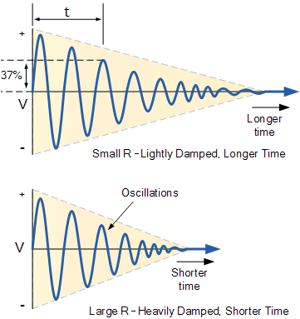
Basics of LC Oscillator Circuit or tank circuit
The energy originally introduced into the circuit through the switch, has been returned to the capacitor which again has an electrostatic voltage potential across it, although it is now of the opposite polarity. The capacitor now starts to discharge again back through the coil and the whole process is repeated. The polarity of the voltage changes as the energy is passed back and forth between the capacitor and inductor producing an AC type sinusoidal voltage and current waveform.
This process then forms the basis of an LC oscillators tank circuit and theoretically this cycling back and forth will continue indefinitely. However, things are not perfect and every time energy is transferred from the capacitor, C to inductor, L and back from L to C some energy losses occur which decay the oscillations to zero over time. Electrical energy is lost in the DC or real resistance of the inductors coil, in the dielectric of the capacitor, and in radiation from the circuit so the oscillation steadily decreases until they die away completely and the process stops.
Then in a practical LC circuit the amplitude of the oscillatory voltage decreases at each half cycle of oscillation and will eventually die away to zero. The oscillations are then said to be “damped” with the amount of damping being determined by the quality or Q-factor of the circuit.

Slide 12
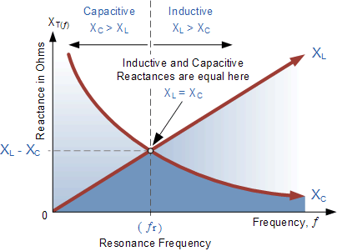
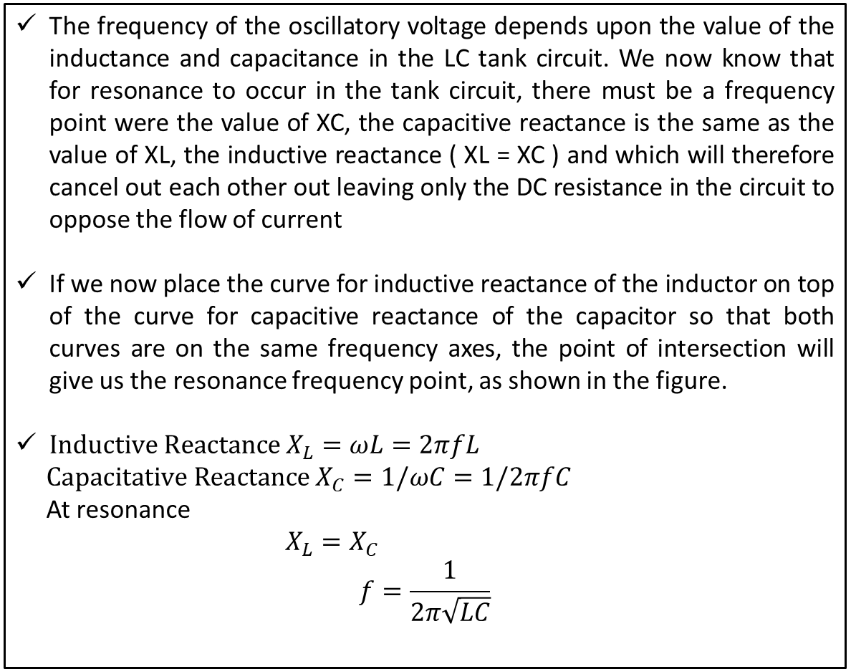
Resonance in LC circuit
The frequency of the oscillatory voltage depends upon the value of the inductance and capacitance in the LC tank circuit. We now know that for resonance to occur in the tank circuit, there must be a frequency point were the value of XC, the capacitive reactance is the same as the value of XL, the inductive reactance ( XL = XC ) and which will therefore cancel out each other out leaving only the DC resistance in the circuit to oppose the flow of current
If we now place the curve for inductive reactance of the inductor on top of the curve for capacitive reactance of the capacitor so that both curves are on the same frequency axes, the point of intersection will give us the resonance frequency point, as shown in the figure.
$Inductive Reactance X_{L}=ωL=2πfL$
$Capacitative Reactance X_{C}=1/ωC=1/2πfC$
At resonance
$X_{L}=X_{C}$
$$f=\frac{1}{2π\sqrt{LC}}$$
Where:
L is the Inductance in Henries
C is the Capacitance in Farads
ƒ is the Output Frequency in Hertz

Slide 13
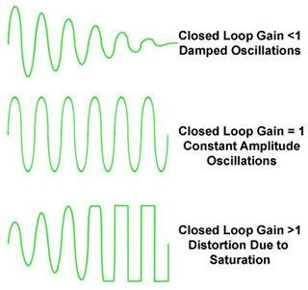
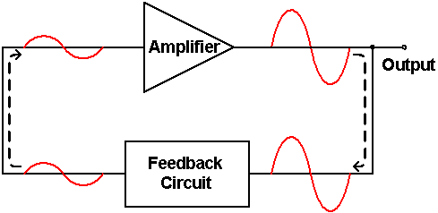
Tackling the losses in LC circuit
To keep the oscillations going in an LC tank circuit, we have to replace all the energy lost in each oscillation and also maintain the amplitude of these oscillations at a constant level. The amount of energy replaced must therefore be equal to the energy lost during each cycle.
If the energy replaced is too large the amplitude would increase until clipping of the supply rails occurs. Alternatively, if the amount of energy replaced is too small the amplitude would eventually decrease to zero over time and the oscillations would stop.
The simplest way of replacing this lost energy is to take part of the output from the LC tank circuit, amplify it and then feed it back into the LC circuit again. This process can be achieved using a voltage amplifier using an op-amp, FET or bipolar transistor as its active device.
To produce a constant oscillation, the level of the energy fed back to the LC network must be accurately controlled. Then there must be some form of automatic amplitude or gain control when the amplitude tries to vary from a reference voltage either up or down.
To maintain a stable oscillation the overall gain of the circuit must be equal to one or unity. Any less and the oscillations will not start or die away to zero, any more the oscillations will occur but the amplitude will become clipped by the supply rails causing distortion. Consider the circuit below.
Action of an amplifier is to amplify

Slide 14
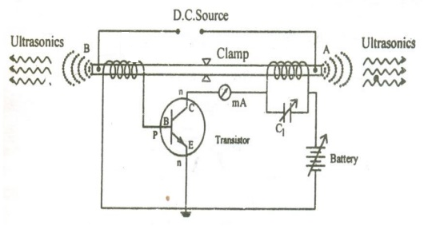
Magnetostriction Method
When the rod is placed inside a magnetic coil carrying alternating current, it suffers a change in length for each half cycle of the alternating current. It means the rod vibrates at a frequency twice than that of the frequency of AC. Usually the amplitude of vibrations are small, but these can be enhanced by achieving the resonance condition i.e. by matching the frequency of the alternating current with the natural frequency of the material of the rod.
The experimental arrangement was designed by G. W. Pierce. The rod is clamped in the middle. L1 and L2 are the two coils wound on the rod. The diameter of the coils is greater than that of the rod, so that, the rod can move freely length wise. Coil L1 is forming a tuned circuit with the variable capacitor C1. which is connected to the collector of the transistor. The coil L2 is connected to the base. The frequency of oscillatory circuit is determined by the values of L1 and C1. If the frequency of the tuned circuit becomes equal to the natural frequency of the rod, then the longitudinal oscillations are set up and ultrasonic waves are produced in the surrounding medium.
L2
L1
The clamps tend to avoid any vertical vibration of the rod in order to make it vibrate only along the length.

Slide 15
Magnetostriction Method
The current flowing in the circuit can be determined by the milliammeter connected across the coil L1.
The necessary biasing i.e. the emitter as forward biased and the collector as reversed biased for NPN transistor can be achieved by the battery connected between the emitter and the collector of the transistor.
The alternating current passing through the coil L1 causes a corresponding change in the magnetization of the rod and hence the rod starts vibrating due to magnetostriction.
L2
L1
Due to converse magnetostriction effect an emf is induced in the coil L2. This induced emf is fed to the base of the transistor, which act as feedback continuously. In this way current is built up in the transistor and the vibration of the rod is maintained. When the frequency of the oscillatory circuit matches with the natural frequency of the vibrating rod, resonance occurs. At resonance the rod vibrates longitudinally with larger amplitude and produces ultrasonic waves of high frequency along both the ends of the rod.

Slide 16
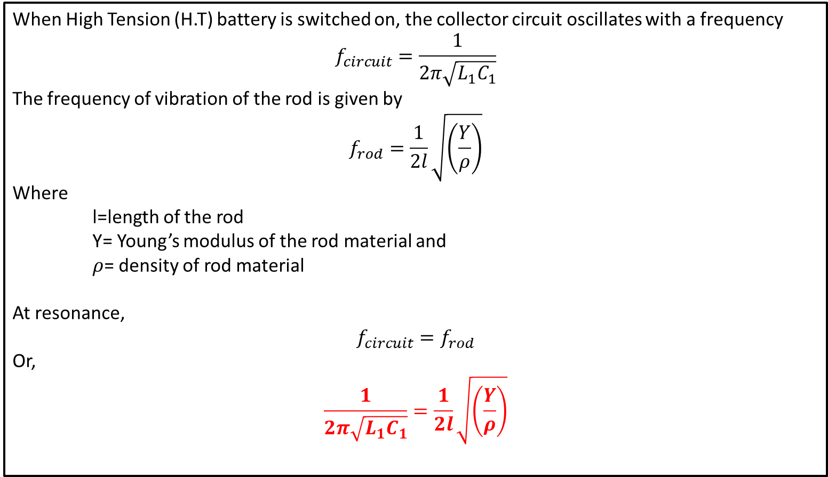
Magnetostriction Method
When High Tension (H.T) battery is switched on, the collector circuit oscillates with a frequency
$$f_{circuit}=\frac{1}{2π\sqrt{L_{1}C_{1}}}$$
The frequency of vibration of the rod is given by
$$f_{rod}=\frac{1}{2l}\sqrt{\left(\frac{Y}{ρ}\right)}$$
Where
l=length of the rod
Y= Young’s modulus of the rod material and
$ρ$= density of rod material
At resonance,
$$f_{circuit}=f_{rod}$$
Or,
$$\frac{1}{2π\sqrt{L_{1}C_{1}}}=\frac{1}{2l}\sqrt{\left(\frac{Y}{ρ}\right)}$$
Young's modulus is a measure of the ability of a material to withstand changes in length when under lengthwise tension or compression.

Slide 17
Magnetostriction Method
Advantages
The design of this oscillator is very simple and its production cost is low
At low ultrasonic frequencies, the large power output can be produced without the risk of damage of the oscillatory circuit.
Disadvantages
It has low upper frequency limit and cannot generate ultrasonic frequency above 3000 kHz (i.e. 3MHz).
The frequency of oscillations depends on temperature.
There will be losses of energy due to hysteresis and eddy current.

Slide 18
Piezoelectric Method

Slide 19
Piezoelectric Method
Certain crystals can develop an electric charge when a mechanical pressure or tension is applied. This effect is called a piezoelectric effect.
The word piezoelectricity means electricity resulting from pressure and heat
There is a direct proportion between the mechanical pressure and the resultant charge.
When the piezoelectric crystals are stretched or compressed along their mechanical axis, the electric potential is developed along the electrical axis (perpendicular to the mechanical axis).
Conversely, when electrical charge is placed on the flat crystal surface and alternating potential difference is applied along the electrical axis, then the mechanical stress will be produced along the mechanical axis. Thus the crystal plate will contract and expand alternatively and starts to vibrate with the frequency of the applied field. At resonance, the amplitude of vibration becomes large. Thus, the converse piezoelectric effect is used to produce ultrasonic wave.
+
Charges Change alternatively
on the parallel plate capacitor and this leads to the mechanical vibration of the quartz crystal. If the vibration is of the order of the desired frequency, then ultrasound is produced
-
Compression Leads to
elongation in height
-
+
-
+
-
+
+
-
+
-
Stretching Leads to
elongation in width
Inverse Piezoelectric effect
Direct Piezoelectric effect

Slide 20
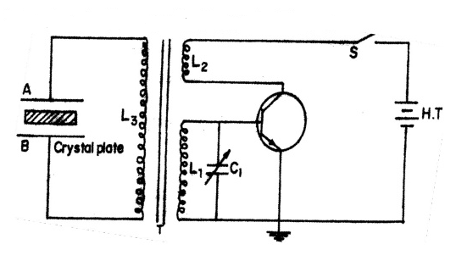
Piezoelectric Method
The quartz crystal is placed between two metal plates A and B.
The plates are connected to the primary (L₃) of a transformer which is inductively coupled to the electronic LC oscillator.
The electronic oscillator circuit is a base tuned oscillator circuit.
The coil L₁ and variable capacitor C₁ form the tank circuit of the oscillator.
The coils L₁ and L₂ of oscillator circuit are taken to form the secondary of a transformer T.
The collector coil L₂ is inductively coupled to base coil L₁.
The coil L₃ lies in the magnetic field of the coil L₁. As result an AC supply is generated in the primary of the transformer coil which changes the polarity charges across the capacitor.
Feedback Circuit
Tank or LC Circuit
Amplifier Circuit

Slide 21
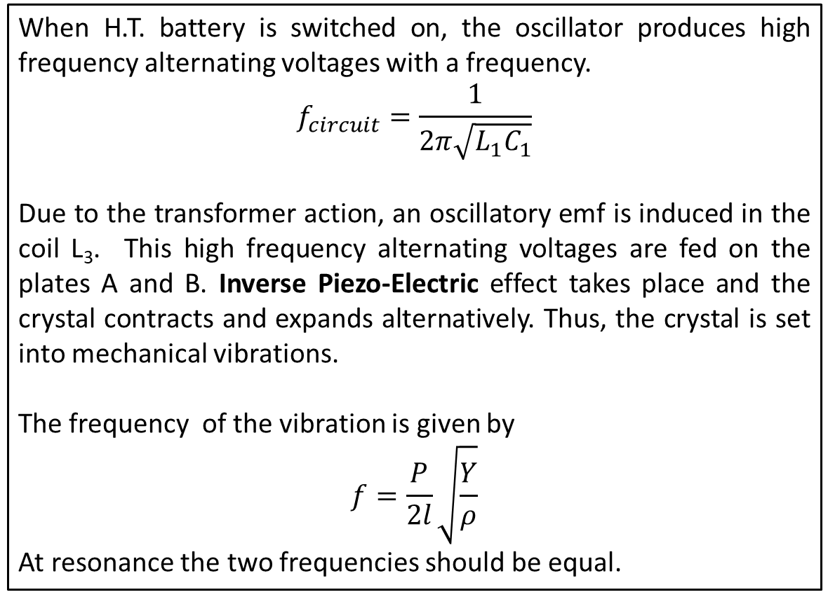
Piezoelectric Method
When H.T. battery is switched on, the oscillator produces high frequency alternating voltages with a frequency.
$$f_{circuit}=\frac{1}{2π\sqrt{L_{1}C_{1}}}$$
Due to the transformer action, an oscillatory emf is induced in the coil L₃. This high frequency alternating voltages are fed on the plates A and B. Inverse Piezo-Electriceffect takes place and the crystal contracts and expands alternatively. Thus, the crystal is set into mechanical vibrations.
The frequency of the vibration is given by
$$f=\frac{P}{2l}\sqrt{\frac{Y}{ρ}}$$
At resonance the two frequencies should be equal.
where P = 1,2,3,4 … etc.
for fundamental, first over tone,
second over tone etc.
Y = Young’s modulus of the crystal and
ρ = density of the crystal.

Slide 22
Piezoelectric Method
Advantages:
Ultrasonic frequencies as high as 5 x 10⁸Hz or 500 MHz can be obtained with this arrangement.
The output of this oscillator is very high.
It is not affected by temperature and humidity.
Disadvantages:
The cost of piezoelectric quartz is very high
The cutting and shaping of quartz crystal are very complex.

